Slide 1

Decentralized Experimentation under Network Interference
Mine Su Erturk

Slide 2
Experiments in Large Companies
Multiple experimenters
~10K experiments/day at AirBnB, Facebook…
No coordination/decentralized
Teams choose experiments and subjects
Can contaminate other experiments
Spillovers in treatment effects
Experiment over the same subject pool
Notes:
Network interference & spillovers in treatment effects.
Multiple experimenters – no coordination
Not enough days to schedule each experiment
How to run experiments while taking into account the potential contamination that can be caused on other experiments
10k thousand experiments every day not enough subgraphs – all partitions will have some overlap or not enough power
Contamination unavoidable – so control it as best as you can
Examples
Facebook during performance review cycles
Airbnb promoting minorities while subsidizing some neighborhoods

Slide 3
Project Goal
Develop a model of decentralized experimentation to study contamination and its effect on outcomes

Slide 4
Related Literature
Experimentation under Interference
Aronow et al. (2017), Aronow and Samii (2013), Wager and Xu (2019), Ugander et al. (2013), Athey et al. (2018), Eckles et al. (2017)
Competition in Networked Markets
Cournot competition in networked markets (Bimpikis et al. 2019)
Optimal commissions and subscriptions in networked markets (Birge et al. 2020)
Notes:
Focus in this area is to come up with clever (cluster) randomization schemes that allows an experimenter to estimate direct and indirect treatment effects

Slide 5
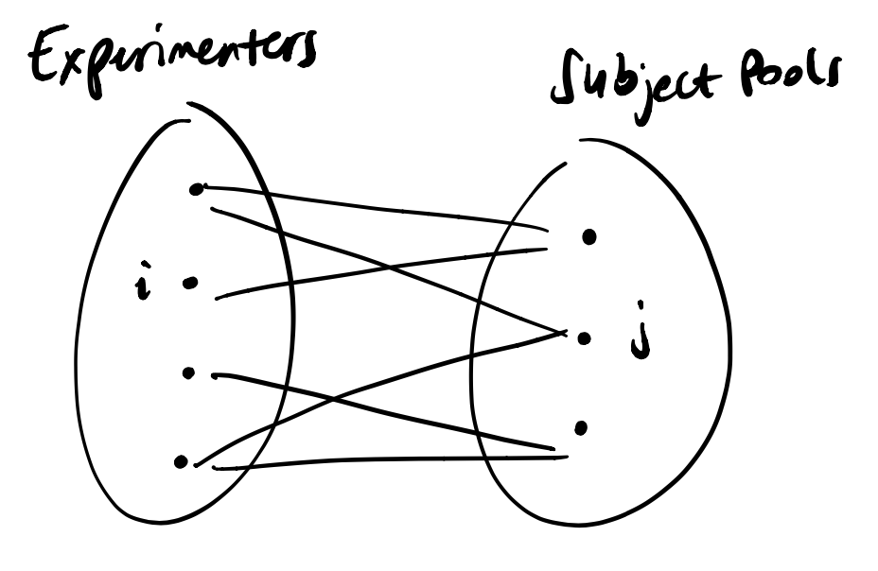
(Preliminary) Analysis
Builds on Bimpikis et al. (2019) and Birge et al. (2020) models
Bipartite graph: experimenters – subject pools
Experimenters compete over subjects
Induces “contamination” across experiments

Slide 6
(Preliminary) Analysis
Builds on Bimpikis et al. (2019) and Birge et al. (2020) models
Bipartite graph: experimenters – subject pools
Experimenters compete over subjects
Induces “contamination” across experiments
Utility ~ statistical power
= f(size of subject pool, size of overlap with others)

Slide 7
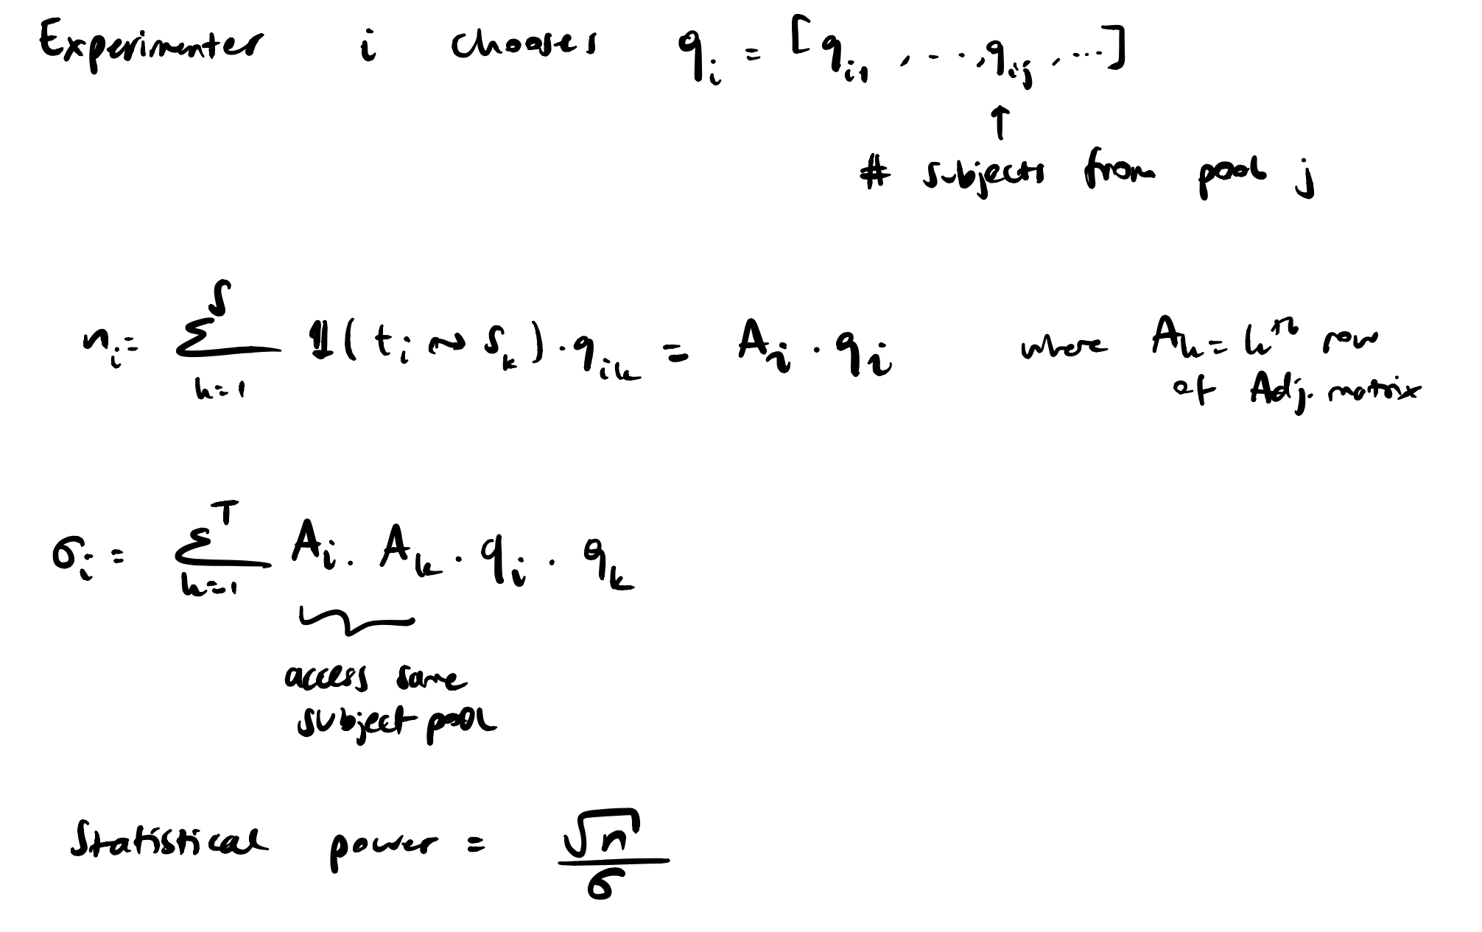
(Preliminary) Analysis

Slide 8
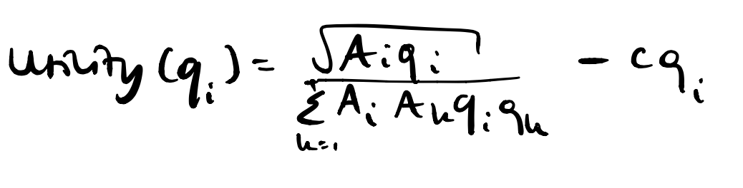
(Preliminary) Analysis

Slide 9
(Preliminary) Analysis
Utility ~ statistical power
= f(size of subject pool, size of overlap with others)
Ignore square root & take log -> linear utility
Similar equilibrium results to Bimpikis et al. (2019) under linear utility

Slide 10
Next Steps
Characterize equilibrium under “realistic” utility function
Understand impact of network topology on competition and “contamination”
Pricing access to subjects -> internalize externalities
Design of decentralized experimentation platforms?
Platform levers?
False discovery problem
Notes:
Relate to variance and statistical power

